Slide 1

Basic Algorithms
Recursion, Greedy, Sorting and Searching
SoftUni Team
Technical Trainers
Software University
https://softuni.bg

Slide 2
Table of Contents
Recursion
Brute-Force Algorithms
Greedy Algorithms
Greedy Failure Cases
Simple Sorting Algorithms
Searching Algorithms

Slide 3
Have a Question?
sli.do
#java-advanced

Slide 4

Recursion

Slide 5

What is Recursion?
A function or a method that calls itself one or more times until a specified condition is met
When it is, the rest of each repetition is processed from the last one called to the first
5

Slide 6
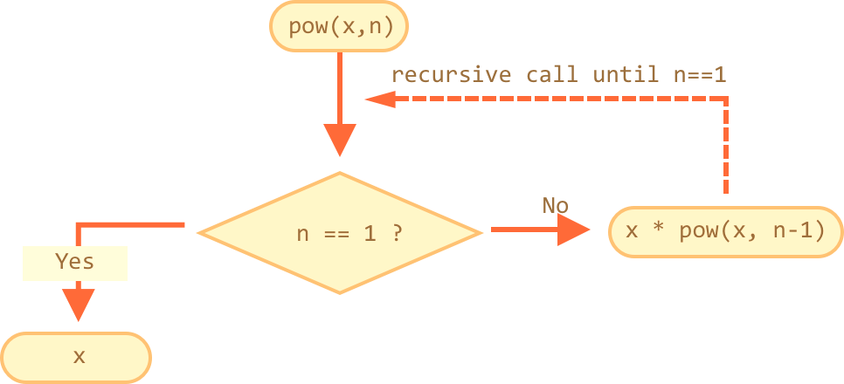
How Does It Work?
The function or method has a base case
Each step of the recursion should move towards the base case
6

Slide 7
Example: Array Sum
Sum(n - 1)
1
2 | 3 | 4
Sum(n)
Sum((n – 1) - 1)
1 | 2 | 3 | 4
1
2
3 | 4
Sum(((n – 1) - 1) – 1)
1
2
3
4
Base case

Slide 8
Example: Recursive Factorial
Recursive definition of n! (n factorial):
Pseudocode
N!
5
120
10
3628800
n! = n * (n–1)! for n > 0
0! = 1

Slide 9
Recursion Pre-Actions and Post-Actions
Recursive methods have 3 parts:
Pre-actions (before calling the recursion)
Recursive calls (step-in)
Post-actions (after returning from recursion)
static void recursion() {
// Pre-actions
recursion();
// Post-actions
}

Slide 10
Direct and Indirect Recursion
Direct recursion
a method directly calls itself
Indirect recursion
Method a calls b, method b calls a
Or even a → b → c → a
void a() {
…
a();
}
void a() {
…
b();
}
void b() {
…
a();
}

Slide 11
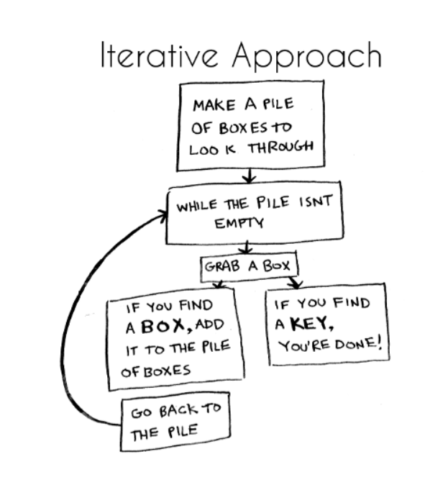
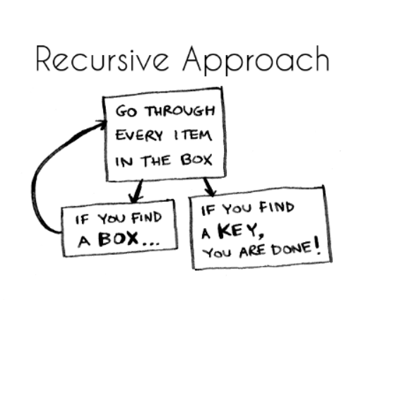
Iterative vs. Recursive Approach
A function repeats a defined process until a condition fails
A function that calls itself repeatedly until a certain condition is met
11

Slide 12

Recursion

Slide 13
Problem: Recursive Array Sum
Write a recursive method that:
Finds the sum of all numbers stored in an int[] array
Read numbers from the console
1 2 3 4
10
-1 0 1
0
Check your solution here: https://judge.softuni.bg/Contests/1701/Basic-Algorithms-Lab

Slide 14
Solution: Recursive Array Sum
static int sum(int[] array, int index) {
if (index == array.length - 1) {
return array[index];
}
return array[index] + sum(array, index + 1);
}
Check your solution here: https://judge.softuni.bg/Contests/1701/Basic-Algorithms-Lab

Slide 15

Problem: Recursive Factorial
Create a recursive method that calculates n!
Read n from the console
5
120
10
3628800
Check your solution here: https://judge.softuni.bg/Contests/1701/Basic-Algorithms-Lab

Slide 16
Solution: Recursive Factorial
static long factorial(int num) {
if (num == 0) {
return 1;
}
return num * factorial(num - 1);
}
Base case
Check your solution here: https://judge.softuni.bg/Contests/1701/Basic-Algorithms-Lab

Slide 17

Brute-Force Algorithms

Slide 18
Brute-Force Algorithms
Trying all possible combinations
Picking the best solution
Usually slow and inefficient
0
0
0
0
0

Slide 19
Brute-Force Algorithms
0
0
0
0
0

Slide 20
Brute-Force Algorithms
0
0
0
0
1

Slide 21
Brute-Force Algorithms
0
0
0
0
2

Slide 22
Brute-Force Algorithms
9
9
9
9
9
10 x 10 x 10 x 10 x 10 = 100,000 combinations

Slide 23

Greedy Algorithms

Slide 24
Greedy Algorithms
Used for solving optimization problems
Usually more efficient than the other algorithms
Can produce a non-optimal (incorrect) result
Pick the best local solution
The optimum for a current position and point of view
Greedy algorithms assume that always choosing a local optimum leads to the global optimum
24

Slide 25
Optimization Problems
Finding the best solution from all possible solutions
Examples:
Find the shortest path from Sofia to Varna
Find the maximum increasing subsequence
Find the shortest route that visits each city and returns to the origin city
25

Slide 26
Greedy Algorithms

Slide 27
Problem: Sum of Coins
Write a program, which gathers a sum of money, using the least possible number of coins
Consider the US currency coins
0.01, 0.02, 0.05, 0.10
Greedy algorithm for "Sum of Coins":
Take the largest coin while possible
Then take the second largest
Etc.
1$
1¢
50¢
5¢
25¢
4¢
Check your solution here: https://judge.softuni.bg/Contests/1701/Basic-Algorithms-Lab

Slide 28
Sum of Coins Visualization
Target: 18
10¢
5¢
2¢
1¢
10¢
5¢
2¢
1¢
Actual:
0

Slide 29
Sum of Coins Visualization
Target: 18
10¢
5¢
2¢
1¢
5¢
2¢
1¢
Actual:
10
10¢

Slide 30
Sum of Coins Visualization
Target: 18
10¢
5¢
2¢
1¢
2¢
1¢
Actual:
15
10¢
5¢

Slide 31
Sum of Coins Visualization
Target: 18
10¢
5¢
2¢
1¢
1¢
Actual:
17
10¢
5¢
2¢

Slide 32

Sum of Coins Visualization
Target: 18
10¢
5¢
2¢
1¢
Actual:
18
10¢
5¢
2¢
1¢

Slide 33
Greedy Algorithm for Sum of Coins

Slide 34
Solution: Sum of Coins (1)
public static Map<Integer, Integer>
chooseCoins(int[] coins, int targetSum) {
List<Integer> sortedCoins = Arrays.stream(coins).boxed()
.sorted(Collections.reverseOrder())
.collect(Collectors.toList());
Map<Integer, Integer> chosenCoins = new LinkedHashMap<>();
int currentSum = 0; int coinIndex = 0;
// Next slide
if (currentSum != targetSum)
throw new IllegalArgumentException();
return chosenCoins;
}
Check your solution here: https://judge.softuni.bg/Contests/1701/Basic-Algorithms-Lab

Slide 35
Solution: Sum of Coins (2)
while (currentSum != targetSum && coinIndex < sortedCoins.size()) {
int currentCoin = sortedCoins.get(coinIndex);
int remainder = targetSum - currentSum;
int numberOfCoins = remainder / currentCoin;
if (currentSum + currentCoin <= targetSum) {
chosenCoins.put(currentCoin, numberOfCoins);
currentSum += numberOfCoins * currentCoin;
}
coinIndex++;
}
Check your solution here: https://judge.softuni.bg/Contests/1701/Basic-Algorithms-Lab

Slide 36
Problem: Set Cover
Write a program that finds the smallest subset of S, the union of which = U (if it exists)
You will be given a set of integers U called "the Universe"
And a set S of n integer sets whose union = U
Universe: 1, 2, 3, 4, 5
Number of sets: 4
1
2, 4
5
3
Sets to take (4):
{ 2, 4 }
{ 1 }
{ 5 }
{ 3 }
Check your solution here: https://judge.softuni.bg/Contests/1701/Basic-Algorithms-Lab

Slide 37
Solution: Set Cover (1)
public static List<int[]> chooseSets(
List<int[]> sets, List<Integer> universe) {
List<int[]> selectedSets = new ArrayList<>();
Set<Integer> universeSet = new HashSet<>();
for (int element : universe) { universeSet.add(element);}
while (!universeSet.isEmpty()) {
// Next Slide
}
return selectedSets;
}
Check your solution here: https://judge.softuni.bg/Contests/1701/Basic-Algorithms-Lab

Slide 38
Solution: Set Cover (2)
int notChosenCount = 0;
int[] chosenSet = sets.get(0);
for (int[] set : sets) {
// Next slide
}
selectedSets.add(chosenSet);
for (int elem : chosenSet) {
universeSet.remove(elem);
}
Check your solution here: https://judge.softuni.bg/Contests/1701/Basic-Algorithms-Lab

Slide 39
Solution: Set Cover (3)
int count = 0;
for (int elem : set) {
if (universeSet.contains(elem)) {
count++;
}
}
if (notChosenCount < count) {
notChosenCount = count;
chosenSet = set;
}
Check your solution here: https://judge.softuni.bg/Contests/1701/Basic-Algorithms-Lab

Slide 40


Greedy Failure Cases

Slide 41
Sum of Coins Failure
Target: 18
10¢
5¢
4¢
1¢
10¢
5¢
4¢
1¢
10¢
5¢
4¢
1¢
Actual:
0

Slide 42
Sum of Coins Failure
Target: 18
10¢
5¢
4¢
1¢
10¢
5¢
4¢
1¢
5¢
4¢
1¢
Actual:
10
10¢

Slide 43
Sum of Coins Failure
Target: 18
10¢
5¢
4¢
1¢
10¢
5¢
4¢
1¢
4¢
1¢
Actual:
15
10¢
5¢

Slide 44
Sum of Coins Failure
Target: 18
10¢
5¢
4¢
1¢
10¢
5¢
4¢
1¢
4¢
Actual:
16
10¢
5¢
1¢

Slide 45
Sum of Coins Failure
Target: 18
10¢
5¢
4¢
1¢
10¢
5¢
4¢
4¢
Actual:
17
10¢
5¢
1¢
1¢

Slide 46
Sum of Coins Failure
Target: 18
10¢
5¢
4¢
10¢
5¢
4¢
4¢
Actual:
18
10¢
5¢
1¢
1¢
1¢

Slide 47

Sum of Coins Failure
Target: 18
10¢
5¢
1¢
1¢
1¢
10¢
4¢
4¢

Slide 48

Optimal Greedy Algorithms

Slide 49
Optimal Greedy Algorithms
Suitable problems for greedy algorithms have these properties:
Greedy choice property
Optimal substructure
Any problem having the above properties is guaranteed to have an optimal greedy solution

Slide 50
Greedy Choice Property
Greedy choice property
A global optimal solution can be obtained by greedily selecting a locally optimal choice
Sub-problems that arise are solved by consequent greedy choices
Enforced by optimal substructure

Slide 51
Optimal Substructure Property
Optimal substructure property
After each greedy choice the problem remains an optimization problem of the same form as the original problem
An optimal global solution contains the optimal solutions of all its sub-problems

Slide 52

Greedy Algorithms: Example
The "Max Coins" game
You are given a set of coins
You play against another player, alternating turns
Per each turn, you can take up to three coins
Your goal is to have as many coins as possible at the end

Slide 53
Max Coins – Greedy Algorithm
A simple greedy strategy exists for the "Max Coins" game
Always choose the local maximum (at each step)
You don't consider what the other player does
You don't consider your actions' consequences
The greedy algorithm works optimally here
It takes as many coins as possible
At each turn take the maximum number of coins

Slide 54

Simple Sorting Algorithms

Slide 55
What is a Sorting Algorithm?
Sorting algorithm
An algorithm that rearranges elements in a list
In non-decreasing order
Elements must be comparable
More formally
The input is a sequence / list of elements
The output is an rearrangement / permutation of elements
In non-decreasing order

Slide 56

Sorting – Example
Efficient sorting algorithms are important for:
Producing human-readable output
Canonicalizing data – making data uniquely arranged
In conjunction with other algorithms, like binary searching
Example of sorting:
Unsorted list
sorting
Sorted list
10 | 3 | 7 | 3 | 4
3 | 3 | 4 | 7 | 10

Slide 57
Sorting Algorithms: Classification
Sorting algorithms are often classified by:
Computational complexity and memory usage
Worst, average and best case behavior
Recursive / non-recursive
Stability – stable / unstable
Comparison-based sort / non-comparison based
Sorting method: insertion, exchange (bubble sort and quicksort), selection (heapsort), merging, serial / parallel, etc.

Slide 58
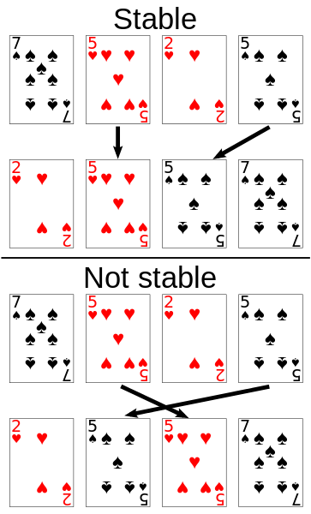
Stability of Sorting
Stable sorting algorithms
Maintain the order of equal elements
If two items compare as equal, their relative order is preserved
Unstable sorting algorithms
Rearrange the equal elements in unpredictable order
Often different elements have same key used for equality comparing

Slide 59
Bubble Sort
Bubble sort – simple, but inefficient algorithm (visualize)
Swaps to neighbor elements when not in order until sorted
Memory: O(1)
Stable: Yes
Method: Exchanging

Slide 60
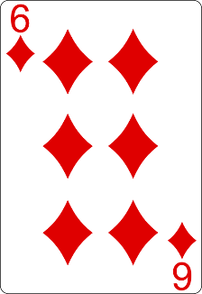
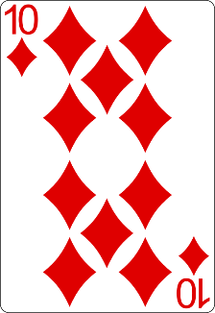
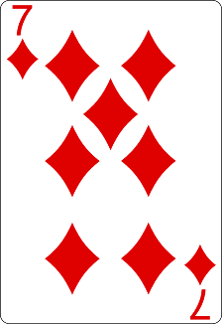
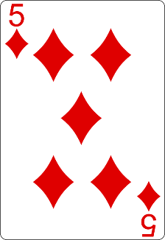
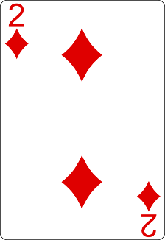
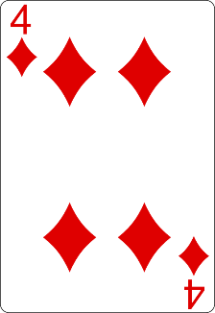
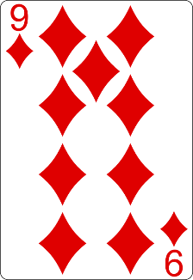
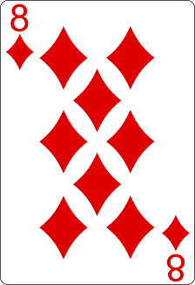
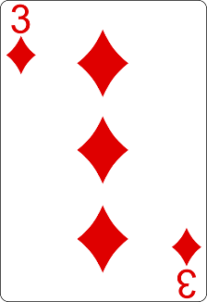
Bubble Sort Visualization
i
j

Slide 61
Bubble Sort Visualization
i
j

Slide 62
Bubble Sort Visualization
i
j

Slide 63
Bubble Sort Visualization
i
j

Slide 64
Bubble Sort Visualization
i
j

Slide 65
Bubble Sort Visualization
i
j

Slide 66
Bubble Sort Visualization
i
j

Slide 67
Bubble Sort Visualization
i
j

Slide 68
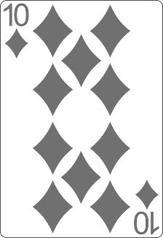
Bubble Sort Visualization
i
j

Slide 69
Bubble Sort Visualization
i
j

Slide 70
Bubble Sort Visualization
i
j

Slide 71
Bubble Sort Visualization
i
j

Slide 72
Bubble Sort Visualization
i
j

Slide 73
Bubble Sort Visualization
i
j

Slide 74
Bubble Sort Visualization
i
j

Slide 75
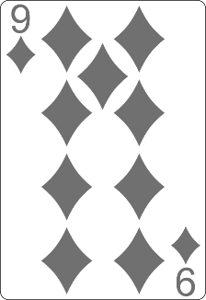
Bubble Sort Visualization
i
j

Slide 76
Bubble Sort Visualization
i
j

Slide 77
Bubble Sort Visualization
i
j

Slide 78
Bubble Sort Visualization
i
j

Slide 79
Bubble Sort Visualization
i
j

Slide 80
Bubble Sort Visualization
i
j

Slide 81
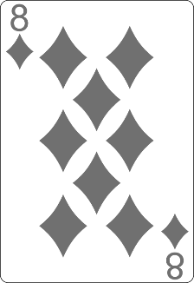
Bubble Sort Visualization
i
j

Slide 82
Bubble Sort Visualization
i
j

Slide 83
Bubble Sort Visualization
i
j

Slide 84
Bubble Sort Visualization
i
j

Slide 85
Bubble Sort Visualization
i
j

Slide 86
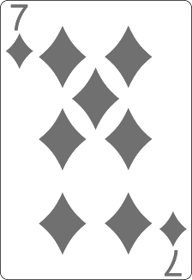
Bubble Sort Visualization
i
j

Slide 87
Bubble Sort Visualization
i
j

Slide 88
Bubble Sort Visualization
i
j

Slide 89
Bubble Sort Visualization
i
j

Slide 90
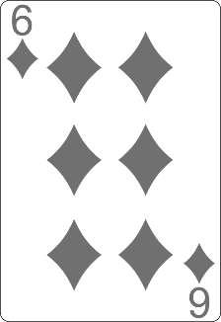
Bubble Sort Visualization
i
j

Slide 91
Bubble Sort Visualization
i
j

Slide 92
Bubble Sort Visualization
i
j

Slide 93
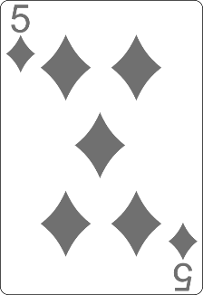
Bubble Sort Visualization
i
j

Slide 94
Bubble Sort Visualization
i
j

Slide 95
Bubble Sort Visualization

Slide 96
BubbleSort

Slide 97
BubbleSort
int[] numbers = {1, 3, 4, 2, 5, 6};
for (int i = 0; i < numbers.length; i++) {
for (int j = i + 1; j < numbers.length - 1; j++) {
if (numbers[i] > numbers[j]) {
int tempNumber = numbers[i];
numbers[i] = numbers[j];
numbers[j] = tempNumber;
}
}
}
//TODO: Print numbers

Slide 98


Searching Algorithms

Slide 99
Search Algorithm
Search algorithm == an algorithm for finding an item with specified properties among a collection of items
Different types of searching algorithms:
For virtual search spaces
Satisfy specific mathematical equations
Try to exploit partial knowledge about a structure
For sub-structures of a given structure
A graph, a string, a finite group
Search for the min / max of a function, etc.

Slide 100
Linear Search
Linear search finds a particular value in a list (visualize)
Checking every one of the elements
One at a time, in sequence
Until the desired one is found
Worst & average performance: O(n)
for each item in the list:
if that item has the desired value,
return the item's location
return nothing

Slide 101
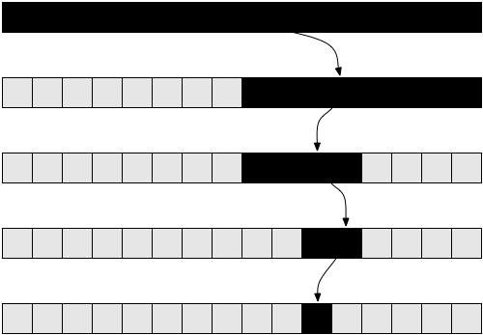
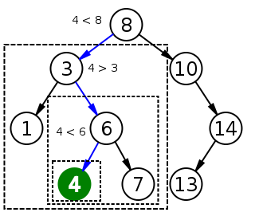
Binary Search
Binary search finds an item within a ordered data structure
At each step, compare the input with the middle element
The algorithm repeats its action to the left or right sub-structure
Average performance: O(log(n))
See the visualization

Slide 102
Binary Search (Iterative)
int binarySearch(int arr[], int key, int start, int end) {
while (end >= start) {
int mid = (start + end) / 2;
if (arr[mid] < key)
start = mid + 1;
else if (arr[mid] > key)
end = mid - 1;
else
return mid;
}
return KEY_NOT_FOUND;
}

Slide 103

Summary
Recursion – a method or a function that calls itself
Brute-Force - trying all the possible solutions
Greedy - picking a locally optimal solution
Sorting
Bubble Sort
Searching
Linear and Binary
…
…
…

Slide 104
Questions?
Notes:
104

Slide 105











SoftUni Diamond Partners

Slide 106



Educational Partners

Slide 107
Trainings @ Software University (SoftUni)
Software University – High-Quality Education, Profession and Job for Software Developers
softuni.bg
Software University Foundation
softuni.foundation
Software University @ Facebook
facebook.com/SoftwareUniversity
Software University Forums
forum.softuni.bg
107
Notes:
107

Slide 108

License
This course (slides, examples, demos, exercises, homework, documents, videos and other assets) is copyrighted content
Unauthorized copy, reproduction or use is illegal
© SoftUni – https://about.softuni.bg
© Software University – https://softuni.bg
Notes:
108

